Slide 1
Predicting Company Outperformance
By: Sameer Ahmed, Trevor Allison, Madeleine Cope, Sanyam Jain, Teagan Milford, and Laurenz Pehl

Slide 2
Overview
Goal:
Scrape text data from 10-K filing, 7A-Management Discussion Section from 10-15 companies in the Industrial sector over 10 years.
Wanted see if the topics talked about by certain companies over time predicted high stock return
Why it Matters:
Stock analysts look for many ways to gain a competitive advantage in predicting future price movements.
With every firm receiving the same information, creative models/solutions are key to gaining an advantage over competitors.

Slide 3
Hypothesis
Companies that are more dynamic will have higher stock return over time

Slide 4
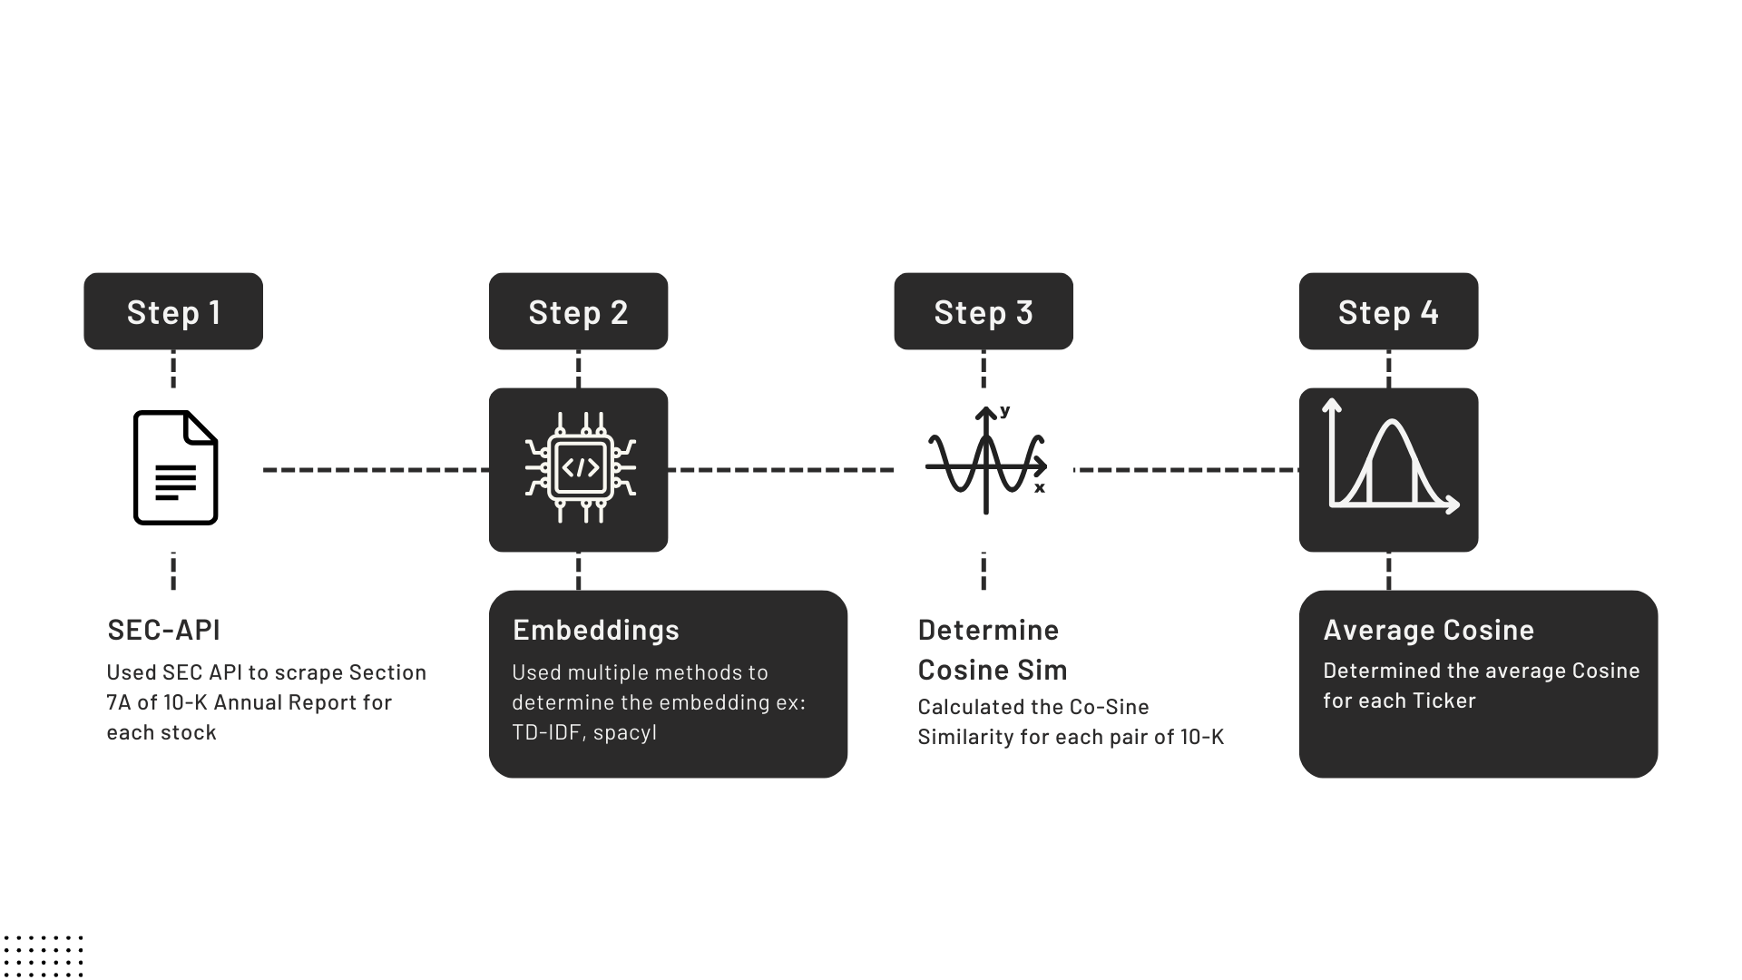
Methods

Slide 5
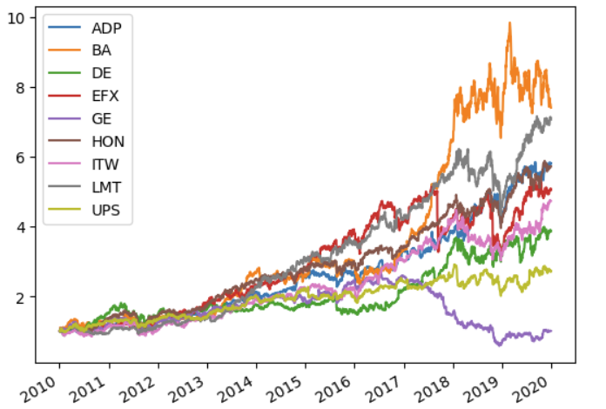
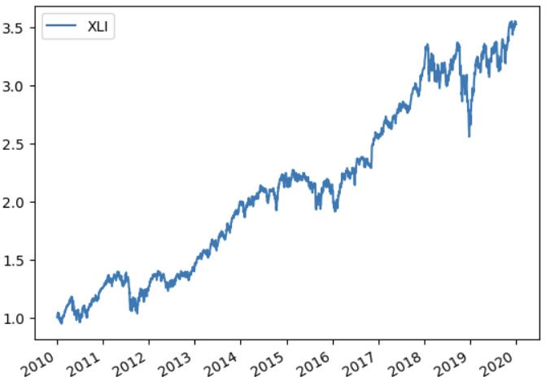
Compound Returns
Individual Returns
Industry Returns
Notes:
We utilized Tiingo to get stock market returns, which is a financial data API that returns various metrics, of which we used adjusted closing prices from 2010-2020.
Compound factor = the value in 2020 of a $1 investment in each stock in 2010 (not adjusted for inflation)
this includes reinvesting dividends or interest
Looking at compound returns provides a more realistic expectation for investments.
We can see that B.A (Boeing) performed the best over this period while G.E. (General Electric) did the worst
Finally, just to give y’all a reference point, the graph on the right shows how the industrials sector as a whole performed over this same time period.

Slide 6
Cosine Similarity
Spacy
TF-IDF
ADP | 0.990319
BA | 0.992253
DE | 0.879401
EFX | 0.998288
GE | 0.868859
HON | 0.998801
ITW | 0.988852
LMT | 0.996967
UPS | 0.996183
ADP | 0.911459
BA | 0.9253109
DE | 0.684378
EFX | 0.9509628
GE | 0.586411
HON | 0.9523259
ITW | 0.8832493
LMT | 0.9635099
UPS | 0.9413465

Slide 7
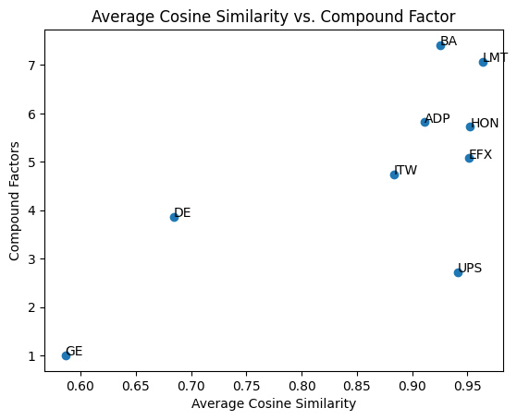
Results

Slide 8
Analysis
Our results indicate that a higher compound factor was positively correlated with a higher cosine similarity, or companies that were less dynamic.
While this is the inverse result of our hypothesis, it still yields important predictive insights.
Potential uses of this data may be for:
Stock trading
Derivatives trading (options, futures, etc)
Company management
Notes:
As noted, the results of our investigation indicated that there was a positive correlation between a higher compound factor and a higher cosine similarity. So, companies whose reports change less from year-to-year experience a higher compound return. This suggests that companies that are more stable over time have more stable returns, perhaps due to less risky ventures. Companies that had a lot of variation in their reports, or low cosine similarity, tended to have lower compound factors, maybe due to volatile investments. Our results suggest that the opposite of our hypothesis is true, which is a useful insight. Potential ways to use this information are stock trading, derivatives trading, or company management, although collecting more data/investigating further would be wise.
There was a positive correlation between a higher compound factor and a higher cosine similarity
Companies whose reports are more stable from year-to-year experienced higher returns
Companies whose reports are more dynamic experienced lower returns
While this disproves our hypothesis, it could be useful for having predictive insights in stock trading, derivatives trading, and company management
For example, this could be applied as an investment strategy if analysts choose to invest based on high cosine similarity.
More data/investigating further would be wise prior to making any investments.

Slide 9
Moving forward
Results:
Hypothesis proven wrong– but we found an interesting trend
Recommendations:
This gives us insight on which stocks perform robustly over time
Better insight on how to invest in the future
Future Research:
-View different industries
-Longer time horizons
-More companies

Slide 10
Thank You
Questions?

